Slide 1
Managing credit risk
in the fintech revolution
Valerie Lim
3 April 2020
Notes:
Hi everyone. Thanks for giving me the opportunity to work with your credit team. share with u how I used machine learning to empower financial managers to make quicker and data-driven lending decision

Slide 2
Why is managing credit risk important?
Credit risk = Late repayment or default
Introduction | Methodology | Results | Conclusion | Future Work
Notes:
Possibility of loss when a borrower. Our cash flows are interrupted, cost of collection increases, some or all of the loan may be written off, resulting in a loss
Managing credit risk is important to protect ourselves from loss of economic capital and bankruptcy
In this ppt, im going to walk u through how I used a classification model that learn by analyzing borrower’s historical data (using both behavioural features and credit risk related features) to assess the likelihood of defaulting, so that financial managers can optimise the balance between potential revenue from lending activities and expected loss from defaulting

Slide 3
Why is managing credit risk important?
Credit risk = Late repayment or default
Implications:
Interrupted cash flows
↑ cost of collection
Lose expected returns
Introduction | Methodology | Results | Conclusion | Future Work
Notes:
Our cash flows are interrupted, cost of collection increases, some or all of the loan may be written off, resulting in a loss
Managing credit risk is important to protect ourselves from loss of economic capital and bankruptcy
In this ppt, im going to walk u through how I used a classification model that learn by analyzing borrower’s historical data (using both behavioural features and credit risk related features) to assess the likelihood of defaulting, so that financial managers can optimise the balance between potential revenue from lending activities and expected loss from defaulting

Slide 4
Why is managing credit risk important?
Credit risk = possibility of loss when a borrower fails to repay a loan on time or default
Implications:
Interrupted cash flows
↑ cost of collection
Lose expected returns
Prevent loss of economic capital and bankruptcy
Introduction | Methodology | Results | Conclusion | Future Work
Notes:
Our cash flows are interrupted, cost of collection increases, some or all of the loan may be written off, resulting in a loss
Managing credit risk is important to protect ourselves from loss of economic capital and bankruptcy
In this ppt, im going to walk u through how I used a classification model that learn by analyzing borrower’s historical data (using both behavioural features and credit risk related features) to assess the likelihood of defaulting, so that financial managers can optimise the balance between potential revenue from lending activities and expected loss from defaulting

Slide 5
Why is managing credit risk important?
Goal
Assess the likelihood of defaulting to optimise the balance between potential revenue from lending activities and expected loss from defaulting
Introduction | Methodology | Results | Conclusion | Future Work
Notes:
Our cash flows are interrupted, cost of collection increases, some or all of the loan may be written off, resulting in a loss
Managing credit risk is important to protect ourselves from loss of economic capital and bankruptcy
In this ppt, im going to walk u through how I used a classification model that learn by analyzing borrower’s historical data (using both behavioural features and credit risk related features) to assess the likelihood of defaulting, so that financial managers can optimise the balance between potential revenue from lending activities and expected loss from defaulting

Slide 6
Methodology
Data
Close to 900,000 borrowers,
over 70 features
Tools
Introduction | Methodology | Results | Conclusion | Future Work

Slide 7
Catboost is selected because of its higher AUC score and lower log loss.
Can F1 score be improved?
Introduction | Methodology | Results | Conclusion | Future Work
Notes:
With the pre-selected features, i built 2 baseline models. Catboost and RF, and Catboost was eventually chosen because it performed better in terms of lower log loss and higher F1 score. But f1 score is relatively low across both models.

Slide 8
Undersampling the number of ‘good’ borrowers increased F1 score by 40%.
*ROC AUC score were 0.92 across all 5 models
Introduction | Methodology | Results | Conclusion | Future Work
Notes:
Highly imbalanced dataset, whereby we’ve 12 times as many borrowers who repay their loans on time (refer to them as good borrowers) vs. those defaulted
After balancing our dataset by undersampling the number of borrowers who repay their loans on time increased F1 score by 40%.
oversampling techniques didn’t work as well as undersampling

Slide 9
Recall = Out of 10 borrowers who would default, the model identified 6 of them.
*ROC AUC score were 0.92 across all 5 models
Introduction | Methodology | Results | Conclusion | Future Work

Slide 10
Precision = Out of 10 defaulters identified by the model, 3 of them truly defaulted
*ROC AUC score were 0.92 across all 5 models
Introduction | Methodology | Results | Conclusion | Future Work

Slide 11
Oversampling number of defaulters did not result in a better model performance than undersampling ‘good’ borrowers
Random Over Sampling
*ROC AUC score were 0.92 across all 5 models
*Log loss were around 0.6 to 0.7 across over- and under-sampled models
Introduction | Methodology | Results | Conclusion | Future Work

Slide 12
Can recall score be further improved? Want a higher recall because minimizing false negative is more important
Random Over Sampling
*ROC AUC score were 0.92 across all 5 models
*Log loss were around 0.6 to 0.7 across over- and under-sampled models
Introduction | Methodology | Results | Conclusion | Future Work
Notes:
There’s still room to improve our recall score.
Want a high recall because I want to minimise false negative, i.e. ppl who would default but we didn’t identify them.

Slide 13
Applying a greater weightage to defaulters class increased recall score by 30%.
*ROC AUC score were 0.69 across both models
Introduction | Methodology | Results | Conclusion | Future Work
Notes:
Tried other GBM but they didn’t perform as well

Slide 14
Catboost performed better than LightGBM
*ROC AUC score were 0.69 across both models
Introduction | Methodology | Results | Conclusion | Future Work
Notes:
Tried other GBM but they didn’t perform as well

Slide 15
Feature Importance
Annual income
Revolving line
utilization rate
Introduction | Methodology | Results | Conclusion | Future Work
Stronger predictors of borrowers’ default:
Annual income
Revolving line utilization rate
Installment
Total number of credit lines
Total credit revolving balance
Debt-to-Income Ratio
Loan amount
Number of open credit lines
Purpose of loan
Notes:
To understand how the model works, let’s dive into the features. The plot below shows the relative importance of each feature
Feature importance tells us the numbers of times the feature is used in a model.

Slide 16
Feature Importance
Home ownership
Number of months since last record
Introduction | Methodology | Results | Conclusion | Future Work
Stronger predictors of borrowers’ default:
Annual income
Revolving line utilization rate
Installment
Total number of credit lines
Total credit revolving balance
Debt-to-Income Ratio
Loan amount
Number of open credit lines
Purpose of loan
Notes:
To understand how the model works, let’s dive into the features. The plot below shows the relative importance of each feature
Feature importance tells us the numbers of times the feature is used in a model.

Slide 17
Business Implications
Repay
(0)
Actual
Default
(1)
Repay
(0)
Default
(1)
Predicted
Introduction | Methodology | Results | Conclusion | Future Work
Notes:
To better uds the model performance, let’s dive into the business implications. use a confusion matrix to depict the results.
Each row rep the actual observation – default (assume those who default refers to positive class) or repay
Each col rep the predicted obs – where the model predicts whether a borrower would default or repay based on a given set of features.

Slide 18
Business Implications
True Negative
False
Positive
Repay
(0)
Actual
False Negative
True
Positive
Default
(1)
Repay
(0)
Default
(1)
Predicted
Introduction | Methodology | Results | Conclusion | Future Work
Notes:
This produces 4 outcomes

Slide 19
Business Implications
True Negative
False
Positive
Repay
(0)
Actual
Default
(1)
Repay
(0)
Default
(1)
Predicted
Introduction | Methodology | Results | Conclusion | Future Work

Slide 20
Business Implications
Benefit =
Total interest received
Repay
(0)
Actual
Default
(1)
Repay
(0)
Default
(1)
Predicted
Introduction | Methodology | Results | Conclusion | Future Work
Notes:
The returns we earned from these 2 group of borrowers is total interest received

Slide 21
Business Implications
False Positive
Costs:
interest rate
less customers →
Intangible costs
e.g. Brand reputation,
customer service
Repay
(0)
Actual
Default
(1)
Repay
(0)
Default
(1)
Predicted
Introduction | Methodology | Results | Conclusion | Future Work
Notes:
In the FP scenario, we wrongly flag a borrower who would repay as someone who would default, it also means we charge genuine customers with higher interest rate since the model predicted them to default on their loan, so we reduce the risk by imposing higher i/r, perhaps higher than they can afford and we could have lost some of them, and this interest earned could potentially be higher. There are also intangible costs such as brand reputation and customer service associated with the higher interest rate.

Slide 22
Business Implications
Repay
(0)
Actual
False Negative
True
Positive
Default
(1)
Repay
(0)
Default
(1)
Predicted
Introduction | Methodology | Results | Conclusion | Future Work

Slide 23
Business Implications
Repay
(0)
Actual
Default
(1)
Cost =
Loan amount - Total payment
Repay
(0)
Default
(1)
Predicted
Introduction | Methodology | Results | Conclusion | Future Work
Notes:
The costs we incur where borrowers truly default is equivalent to the difference between loan amount and total payment.

Slide 24
Business Implications
Repay
(0)
Actual
False Negative
Default
(1)
Charged a lower interest rate →
Repay
(0)
Default
(1)
Predicted
Introduction | Methodology | Results | Conclusion | Future Work
Notes:
it also means we did not charge them high enough i/r to account for risk since the model predicted them to be genuine customers. Lower expected return

Slide 25
Given James’ profile, should you issue a loan to him?
Annual income
Revolving line utilization rate
Installment
Total number of credit lines
Total credit revolving balance
Debt-to-Income Ratio
Loan amount
Purpose of loan
Length of employment
Number of inquiries in past 6 months
Number of months since last delinquency
$ 30,000
9.4
60
4
$ 1,700
1
$ 2,500
Car
< 1 year
5
10
Introduction | Methodology | Results | Conclusion | Future Work
Notes:
In sum, this model empowers financial managers to make data-informed decision. Given james profile,

Slide 26
Given James’ profile, should you issue a loan to him?
Annual income
Revolving line utilization rate
Installment
Total number of credit lines
Total credit revolving balance
Debt-to-Income Ratio
Loan amount
Purpose of loan
Length of employment
Number of inquiries in past 6 months
Number of months since last delinquency
$ 30,000
9.4
60
Outcome | Probability
Repay the loan | 0.3
Default | 0.7
4
$ 1,700
1
$ 2,500
Car
< 1 year
5
10
Introduction | Methodology | Results | Conclusion | Future Work
Notes:
This model predicts that James has a 70% chance of defaulting

Slide 27
Given James’ profile, should you issue a loan to him?
Annual income
Revolving line utilization rate
Installment
Total number of credit lines
Total credit revolving balance
Debt-to-Income Ratio
Loan amount
Purpose of loan
Length of employment
Number of inquiries in past 6 months
Number of months since last delinquency
$ 30,000
9.4
60
Outcome | Probability
Repay the loan | 0.3
Default | 0.7
4
$ 1,700
Threshold: 0.5
1
$ 2,500
Predicted outcome
1
Car
< 1 year
5
10
Introduction | Methodology | Results | Conclusion | Future Work
Notes:
More likely to default. And this indicates that financial managers should exercise caution before issuing him a loan

Slide 28
Future Work
1. Modeling
Explore whether other behavioural and loan related features improve model performance
Automate less risky loans
Introduction | Methodology | Results | Conclusion | Future Work
Notes:
There are 3 areas where I’d like to work on .
Divert time and cost savings to loans that are higher rrisk

Slide 29
Future Work
1. Modeling
Explore whether other behavioural and loan related features improve model performance
Automate less risky loans
2. Post-modeling
Develop customized repayment methods to minimise credit risk from defaulters
Introduction | Methodology | Results | Conclusion | Future Work
Notes:
Secondly, Given the profile of defaulters, -- adjust installements, i/r

Slide 30
Future Work
1. Modeling
Explore whether other behavioural and loan related features improve model performance
Automate less risky loans
2. Post-modeling
Develop customized repayment methods to minimise credit risk from defaulters
3. Model maintenance
Detect Drifting Models
- If a metric falls below the threshold, retrain the model using new observations
Introduction | Methodology | Results | Conclusion | Future Work

Slide 31


Thank you!
Find me here!
Valerie Lim
linkedin.com/in/valerie-lim-yan-hui/
valerieeelimyh@gmail.com
github.com/valerielimyh
medium.com/@valerieeelimyh

Slide 32
Appendix

Slide 33
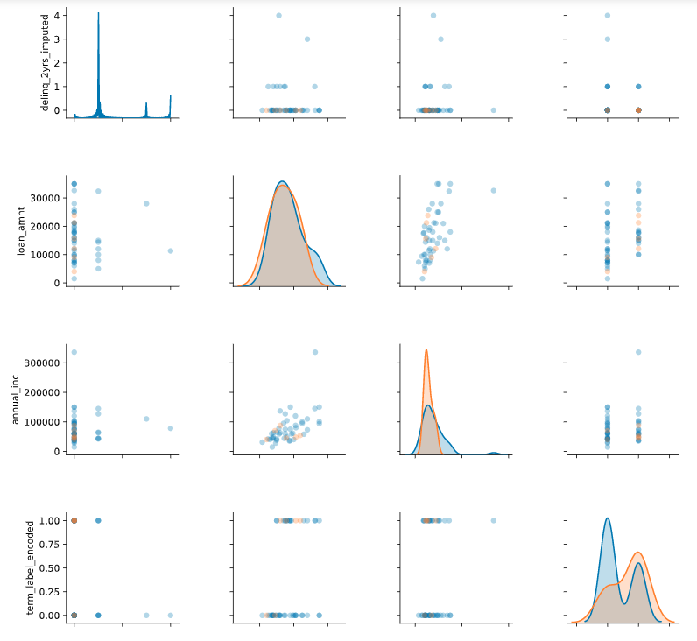
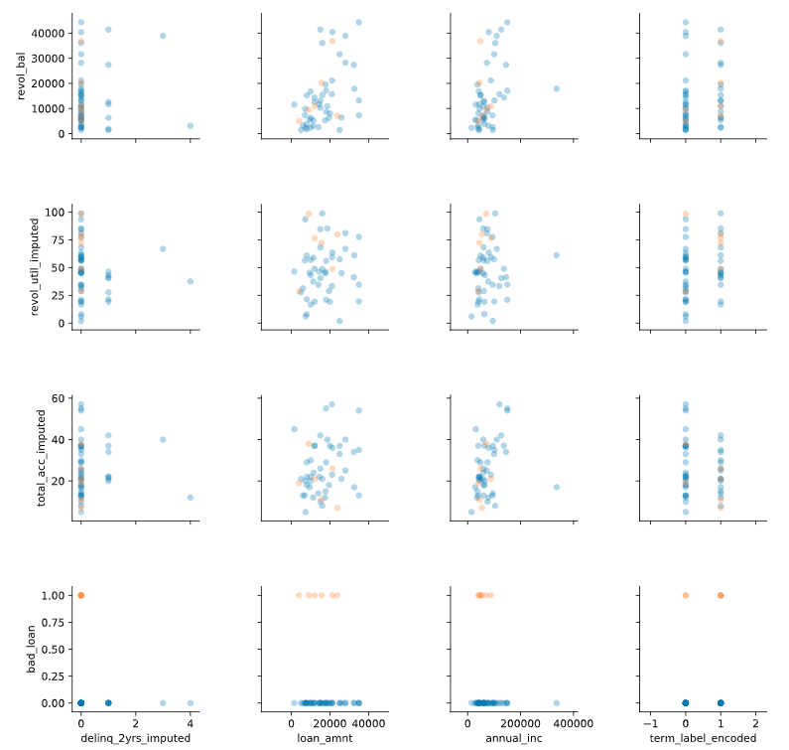
Pairplot of features

Slide 34
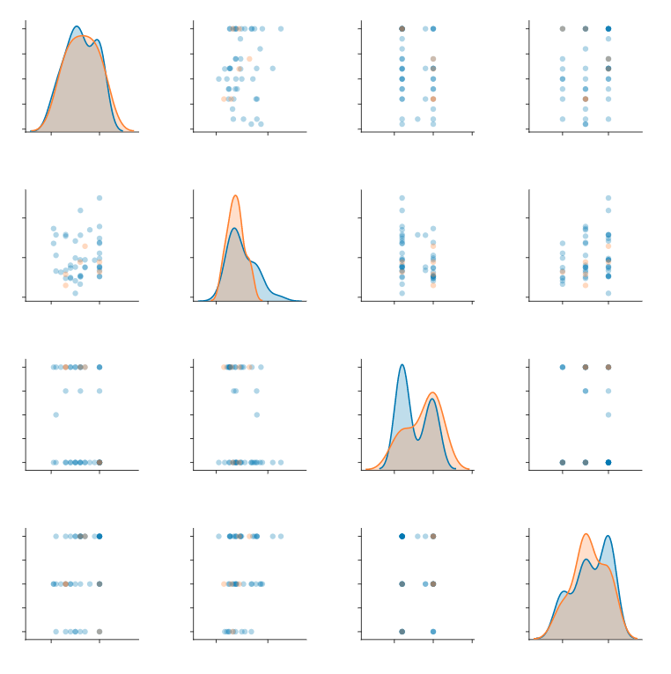
Pairplot of features

Slide 35
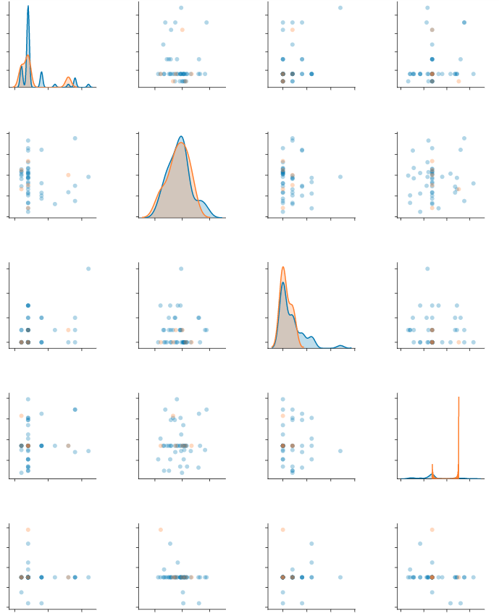
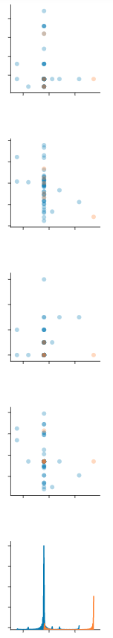
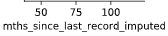
Pairplot of features

Slide 36
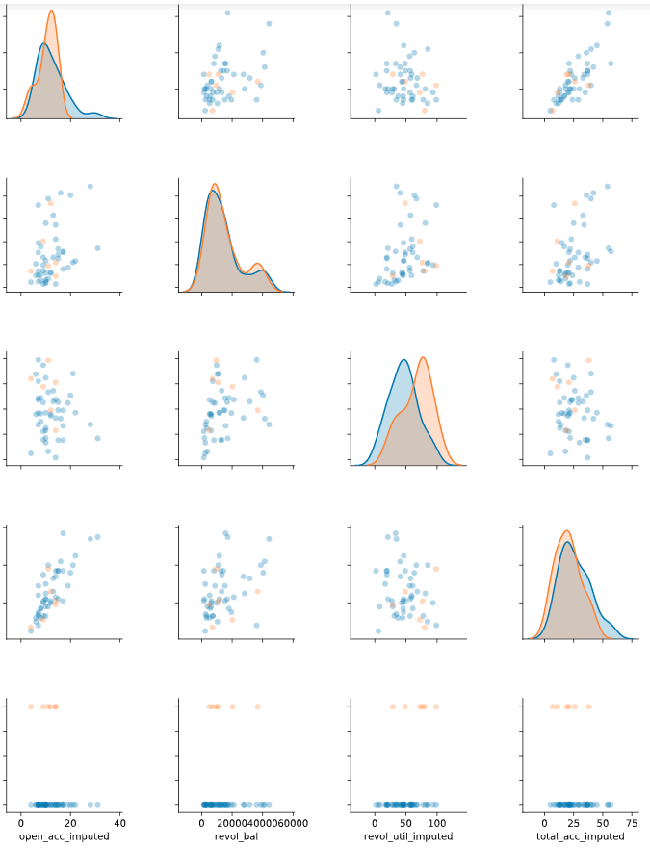
Pairplot of features

Slide 37
Feature Selection using Random Forest
Feature | Feature Importance Score
Debt-to-Income Ratio | 0.11
Revolving line utilization rate | 0.11
Annual income | 0.1
Installment | 0.1
Revolving balance | 0.1
Total number of credit lines | 0.08
Loan amount | 0.07
Number of open credit lines | 0.06
Length of employment | 0.05
Number of months since last delinquency | 0.05
Term | 0.03
Purpose | 0.03
Number of inquiries in past 6 months | 0.03
Home ownership | 0.03
Verification status | 0.03
Number of months since last public record | 0.02
Number of 30+ days past-due delinquencies for the past 2 years | 0.01
Notes:
I selected features based on their Information Value (IV), which ranks features based on how well they predict the target. I used these 9 features to create the model, and obtained similar results as using all features you saw earlier, suggesting those that were dropped were very poor predictors of subscription behaviour.
Revolving line utilization rate, or the amount of credit the borrower is using relative to all available revolving credit.
Total credit revolving balance
The total number of credit lines currently in the borrower's credit file
The number of open credit lines in the borrower's credit file.
The number of months since the borrower's last delinquency.
The number of payments on the loan. Values are in months and can be either 36 or 60.
A category provided by the borrower for the loan request.
The number of inquiries in past 6 months (excluding auto and mortgage inquiries)
The number of months since the last public record.
The number of 30+ days past-due incidences of delinquency in the borrower's credit file for the past 2 years

